Slide 1
Managerial Accounting
Lecture 06: Cost-Volume-Profit (CVP) Analysis
Chapter
23
Masud Jahan
Department of Science and Humanities
Military Institute of Science and Technology

Slide 2
Cost-Volume-Profit Relationships
Cost-volume-profit (CVP) analysis is used to answer questions such as:
  How much must I sell to earn my desired income?
  How will income be affected
  if I reduce selling prices to
  increase sales volume?
  What will happen to
  profitability if I expand
  capacity?
<number>/64
Notes:
Cost-volume-profit analysis will allow us to answer many questions and make important decisions involving the relationships between the volume of activity and costs and revenues. Before we can answer these questions using cost-volume-profit analysis, we must first study cost behavior.

Slide 3
Fixed Costs
Total fixed costs remain unchanged
when activity changes.
Monthly factory rent does not change
when production level is more or less.
Monthly Factory Rent
Units produced
<number>/64
Notes:
We begin our study of cost behavior with fixed costs. Your basic land-line telephone has a monthly connect charge that remains constant regardless of the number of local calls that you might make. The monthly charge that is independent of call activity is a fixed cost..

Slide 4
Fixed Costs
Fixed costs per unit decline as activity increases.
Factory rent per unit
produced declines as
more units are produced
Per unit
factory rent
Units produced
<number>/64
Notes:
Fixed costs per unit decline as activity increases. Dividing your fixed monthly connect fee by more local calls reduces the cost per call by spreading the fixed amount over a higher number of calls. For example, if your monthly connect charge is twenty Tk and you make forty local calls in a month, your cost per local call is fifty cents. If you make one hundred local calls in a month, your cost per local call is twenty cents.

Slide 5
Variable Costs
  Total variable costs change when activity changes.
Total Electricity Bill
Your total Electricity bill is based
on how many units you used.
Units used
<number>/64
Notes:
Total variable costs increase as activity increases. For most people, the total land-line long distance telephone bill is based on the number of minutes talked. So there’s a direct relationship between the number of minutes talked and your total bill. You can see a graph of that relationship in the lower left-hand part of your screen.

Slide 6
Variable Costs
Variable costs per unit do not change
as activity increases.
Per unit Electricity Bill
The cost per unit used is constant.
For example, Tk 3 per unit .
Units used
<number>/64
Notes:
The cost per land-line long distance minute talked is normally constant. For example, for your service, it may be ten cents per minute. Talking more or less minutes will not change the per minute charge. So, on a per unit basis, variable costs remain unchanged. You can see the graph of that in the lower right-hand side of your screen.

Slide 7
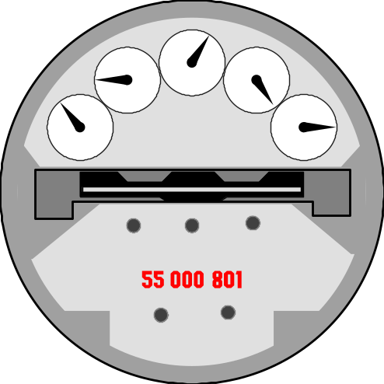
Semi variable Costs (Mixed Costs)
Mixed costs contain a fixed portion that is incurred even
when facility is unused, and a variable portion that
increases with usage.
Example: Monthly fixed phone bill
  Fixed line rent
  Variable charge per
  minute talked
<number>/64
Notes:
Many costs are mixed in nature. That is, they have both a fixed and variable component. Think about your utility bill. You have a fixed monthly charge for the hook-up, and the variable portion of your bill depends upon the number of kilowatt hours you use. The more the kilowatt hours you use, the higher your total utility bill will be.

Slide 8


Semi variable Costs (Mixed Costs)
Slope is
variable cost
per unit
of activity.
Total mixed cost
Variable
Utility Charge
Total Utility Cost
Fixed Monthly
Utility Charge
Activity (minute talked)
<number>/64
Notes:
Here we see a graph with utility cost on the vertical axis and kilowatt hours on the horizontal axis. Notice that the fixed monthly charge is the same at all levels of kilowatt usage, even the zero level of usage. The variable cost, which rises as more kilowatt hours are used, is added to the fixed cost to obtain the total mixed cost.

Slide 9
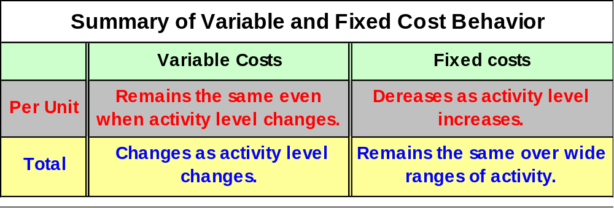
Cost Behavior Summary
<number>/64
Notes:
We know that some of the language we use to differentiate fixed and variable costs in total and per unit can be very confusing when you first see it. So we’ve prepared this chart to help you identify how those costs behave.

Slide 10

Learning Objective
To explain how economies of
scale can reduce unit costs.
LO2
<number>/64
Notes:
Learning objective number 2 is to explain how economies of scale can reduce unit costs.

Slide 11
Economies of Scale
Consider machinery rent example.
Monthly machinery rent per unit manufactured
Fixed costs per unit
decline as activity increases.
Total Units manufactured
<number>/64
Notes:
Recall our earlier telephone example.
Fixed costs per unit decline as activity increases. Dividing your fixed monthly connect fee by more local calls reduces the cost per call by spreading the fixed amount over a higher number of calls. For example, if your monthly connect charge is twenty Tk and you make forty local calls in a month, your cost per local call is fifty cents. If you make one hundred local calls in a month, your cost per local call is twenty cents.

Slide 12

Economies of Scale
Economies of scale are most apparent
in business with high fixed costs.
Utility
Companies
Steel
Mills
Oil
Refineries
Airlines
<number>/64
Notes:
Economies of scale are most important in business with high fixed costs such as utility companies, steel mills, oil refineries, and airlines. The high level of fixed costs in these companies result from the large amounts of capital invested in plant and equipment.

Slide 13
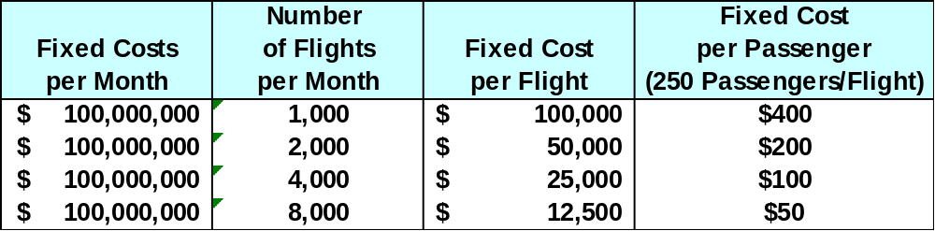
Economies of Scale
Economies of scale are most apparent
in business with high fixed costs.
Airlines
<number>/64
Notes:
For example, an airline company with fixed costs of Tk 100,000,00 per month would see its fixed costs per flight decrease from Tk 100,000 per flight to Tk 12,500 per flight as the number of flights per month increases from 1,000 to 8,000.

Slide 14

Stair-Step Costs
Total cost remains
constant within a
narrow range of
activity.
Cost
Activity
<number>/64
Notes:
Another type of cost is referred to as a step cost. Step costs remain constant in total within a relatively narrow range of activity.

Slide 15
Stair-Step Costs
Total cost increases to a
new higher cost for the next higher range of activity.
Cost
Activity
<number>/64
Notes:
Total step costs increase as the level of activity increases beyond the initial narrow range of activity.

Slide 16
Learning Objective
To prepare a
cost-volume-profit
graph.
LO3
<number>/64
Notes:
Learning objective number 3 is to prepare a cost-volume-profit graph.

Slide 17
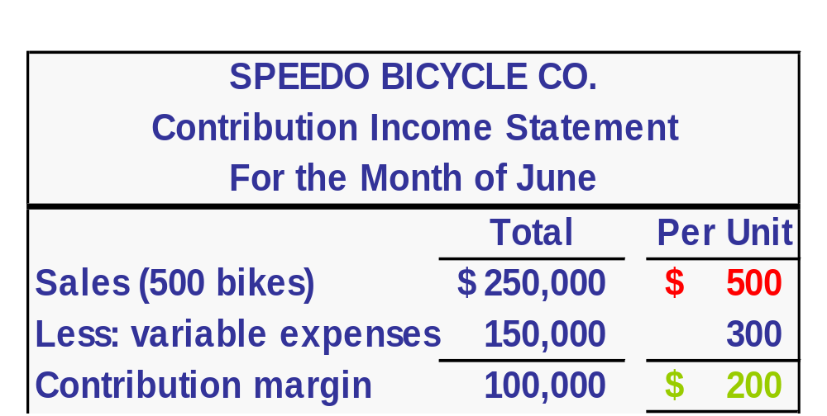
The Basics of Cost-Volume-Profit (CVP) Analysis
CM can be expressed
in total or per unit.
Contribution margin (CM) is the difference between
sales revenue and variable expenses.
The CM ratio is computed by dividing the
per unit contribution margin by the per unit selling price.
Tk 200 ÷ Tk 500 = 40%
<number>/64

Slide 18
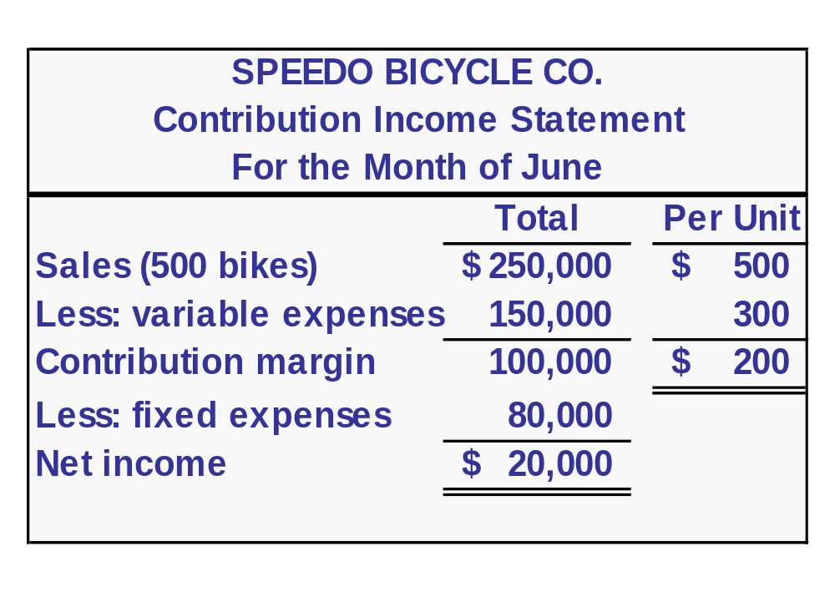
The Basics of Cost-Volume-Profit (CVP) Analysis
After fixed expenses are covered,
any additional contribution margin
results in net income.
<number>/64

Slide 19
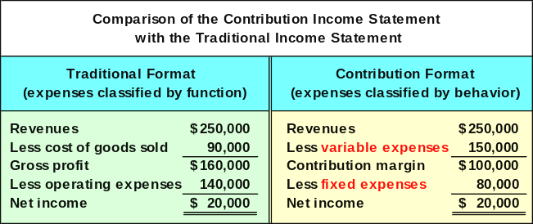
The Contribution Margin Format
Used primarily for
external reporting.
Used primarily by
management.
<number>/64

Slide 20
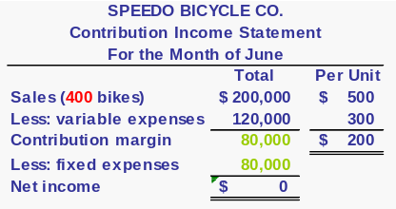
Break-Even Point
Speedo has $ 80,000 of fixed expenses.
If Speedo sells 400 units in a month,
Speedo will generate $ 80,000 in total CM
($ 200 CM per unit x 400 units).
Speedo will be operating at its break-even point.
<number>/64

Slide 21
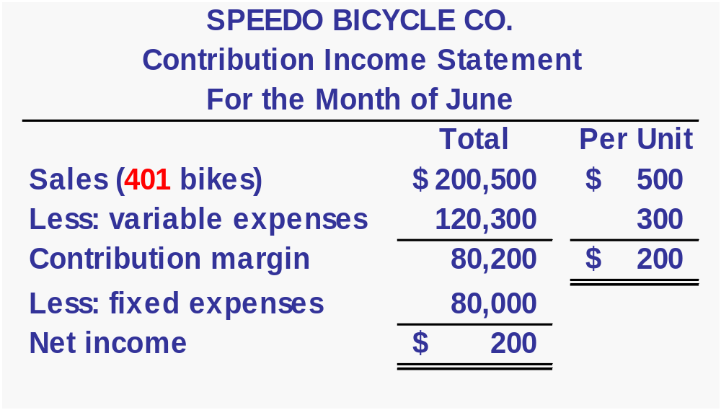
Additional Unit Sales
If Speedo sells one additional unit
(that is, 401 bikes), net income will be $ 200.
Net income will increase by Tk 200 (the CM per unit)
as each additional unit is sold.
<number>/64

Slide 22
The Contribution Approach
The break-even point can be defined as:
  The point where total contribution
  margin equals total fixed expenses.
  The point where total sales revenue
  equals total expenses (variable and
  fixed).
Break-even analysis can be approached
in two ways - contribution margin method
or equation method.
Covered here
<number>/64

Slide 23
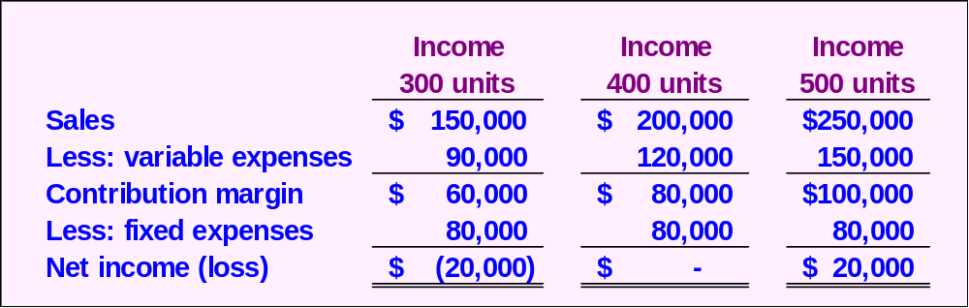

CVP Relationships in Graphic Form
Viewing CVP relationships in a graph gives managers a perspective that can be obtained in no other way.
Consider the following information for Speedo Company:
<number>/64

Slide 24
Preparing a CVP Graph
Starting at the origin, draw the total revenue
line with a slope equal to the unit sales price.
Revenue
Total fixed cost
extends horizontally
from the vertical axis.
Costs and Revenue
in Dollars
Total fixed cost
Volume in Units
<number>/64
Notes:
In this graph we have plotted costs and revenues on the vertical axis and volume in units on the horizontal axis. The sales revenue line begins at the origin and has a slope equal to the unit sales price. The total fixed cost line is horizontal, indicating no change in fixed cost when volume increases.

Slide 25
Preparing a CVP Graph
Revenue
Draw the total cost line with a slope
equal to the unit variable cost.
Break-even
Point
Profit
Costs and Revenue
in Dollars
Total cost
Loss
Total fixed cost
Volume in Units
<number>/64
Notes:
The total cost line has a slope equal to the variable cost per unit and intercepts the vertical cost axis at the fixed cost. We see the break-even point where the sales revenue line crosses the total cost line. The sales line is steeper, that is increases at a faster rate, than the total cost line because the unit sales price is greater than the unit variable cost. Below the break-even point, we see losses, and above the break-even point, we see profits.

Slide 26
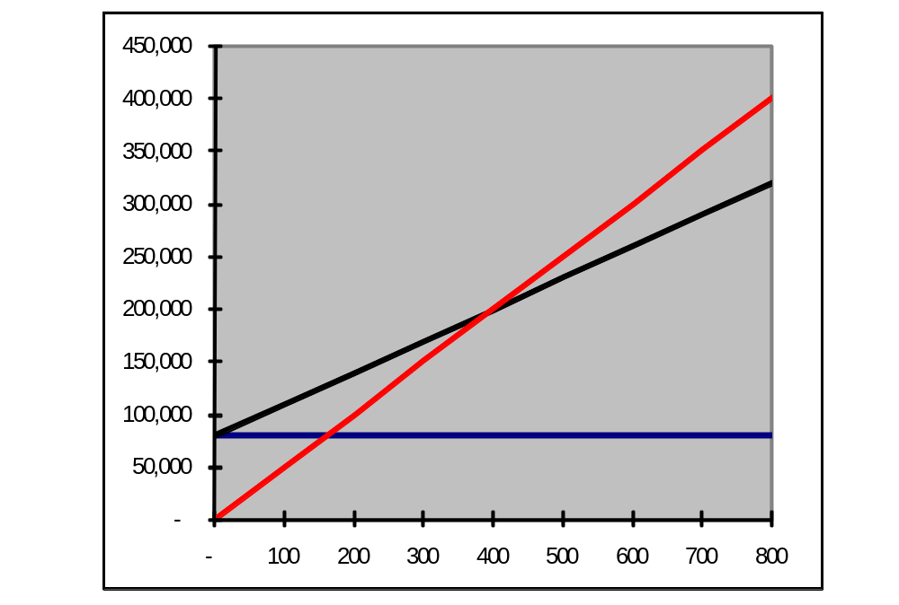
CVP Graph
Total Sales
Profit Area
Total Expenses
Costs and Revenue in Dollars
Break-even point
Loss Area
Fixed Expenses
Volume in Units
<number>/64

Slide 27
Learning Objective
To compute the contribution
margin and explain
its usefulness.
LO4
<number>/64
Notes:
Learning objective number 7 is to use CVP relationships to evaluate a new marketing strategy.

Slide 28

Computing Break-Even Point
The break-even point (expressed in units of product or Tk of sales) is the unique sales level at which a company neither earns a profit nor incurs a loss.
<number>/64
Notes:
The break-even point is the level of sales where a company’s income is exactly equal to zero. At breakeven, total costs equal total revenues.

Slide 29
Formula for Computing
Break-Even Sales (in Units)
We have just seen one of the basic CVP relationships – the break-even computation.
Fixed costs
Break-even point in units =
Contribution margin per unit
Unit sales price less unit variable cost
(Tk 20 in previous example)
<number>/64
Notes:
The results of the previous question can be expressed in equation form as seen on your screen. The break-even point in units is equal to fixed costs divided by the unit contribution margin.

Slide 30
Formula for Computing
Break-Even Sales (in Tk)
The break-even formula may also be expressed in sales Tk or $.
Fixed costs
Break-even point in Tk =
Contribution margin ratio
Contribution margin per unit
Unit sales price
<number>/64
Notes:
The break-even point in sales Tk is equal to fixed costs divided by the contribution margin ratio. The contribution margin ratio is equal to the the unit contribution divided by the unit sales price. In the earlier example the contribution margin ratio is 40 percent, resulting from dividing the Tk 20 per unit contribution margin by the Tk 50 per unit sales price. You might want to refer back to the example to verify these numbers. The contribution margin ratio tells us that forty cents of each sales dollar contributes to covering fixed costs and providing for income.
Let’s look at a couple of questions to see if we have these concepts mastered.

Slide 31
Computing Break-Even Sales
ABC Co. sells product XYZ at Tk 5.00 per unit. If fixed costs are Tk 200,000 and variable costs are Tk 3.00 per unit, how many units must be sold to break even?
a. 100,000 units
b. 40,000 units
c. 200,000 units
d. 66,667 units
<number>/64
Notes:
Here’s your first question.

Slide 32
Computing Break-Even Sales
ABC Co. sells product XYZ at Tk 5.00 per unit. If fixed costs are Tk 200,000 and variable costs are Tk 3.00 per unit, how many units must be sold to break even?
a. 100,000 units
b. 40,000 units
c. 200,000 units
d. 66,667 units
Unit contribution = Tk 5.00 - Tk 3.00 = Tk 2.00
Fixed costs
Unit contribution
Tk 200,000
Tk 2.00 per unit
=
= 100,000 units
<number>/64
Notes:
The unit contribution margin is two Tk. The break-even point in units is equal to Tk 200,000 in fixed costs divided by the two Tk unit contribution margin.

Slide 33
Computing Break-Even Sales
Use the contribution margin ratio formula to determine the amount of sales revenue ABC must have to break even. All information remains unchanged: fixed costs are Tk 200,000; unit sales price is Tk 5.00; and unit variable cost is Tk 3.00.
a. Tk 200,000
b. Tk 300,000
c. Tk 400,000
d. Tk 500,000
<number>/64
Notes:
Here’s your second question using the same information.

Slide 34
Computing Break-Even Sales
Use the contribution margin ratio formula to determine the amount of sales revenue ABC must have to break even. All information remains unchanged: fixed costs are Tk 200,000; unit sales price is Tk 5.00; and unit variable cost is Tk 3.00.
a. Tk 200,000
b. Tk 300,000
c. Tk 400,000
d. Tk 500,000
Unit contribution = Tk 5.00 - Tk 3.00 = Tk 2.00
Contribution margin ratio = Tk 2.00 ÷ Tk 5.00 = .40
Break-even revenue = Tk 200,000 ÷ .4 = Tk 500,000
<number>/64
Notes:
The 40 percent contribution margin ratio is equal to the the two Tk unit contribution divided by the five Tk unit sales price. The break-even point in sales Tk is equal to Tk 200,000 thousand Tk in fixed costs divided by the 40 percent contribution margin ratio.

Slide 35
Learning Objective
Determine the sales volume
required to earn a desired
level of operating income.
LO5
<number>/64
Notes:
Learning objective number 6 is to use the contribution margin to estimate the change in operating income caused by a change in sales volume.

Slide 36
Computing Sales Needed to Achieve Target Operating Income
Break-even formulas may be adjusted to show the sales volume needed to earn
any amount of operating income.
Fixed costs + Target income
Unit sales =
Contribution margin per unit
Fixed costs + Target income
Amount sales =
Contribution margin ratio
<number>/64
Notes:
We can adjust the break-even formulas that we used earlier to incorporate income. Recall that we calculated breakeven by dividing fixed costs by contribution. When we incorporate income, contribution must cover the fixed cost as well as provide for income. To adapt the break-even formulas for income, we add the desired amount of income to the numerator.
Let’s see if we can use these formulas to answer a question.

Slide 37
Computing Sales Needed to Achieve Target Operating Income
ABC Co. sells product XYZ at Tk 5.00 per unit. If fixed costs are Tk 200,000 and variable costs are Tk 3.00 per unit, how many units must be sold to earn operating income of Tk 40,000?
a. 100,000 units
b. 120,000 units
c. 80,000 units
d. 200,000 units
<number>/64
Notes:
Here’s your question.

Slide 38
Computing Sales Needed to Achieve Target Operating Income
ABC Co. sells product XYZ at Tk 5.00 per unit. If fixed costs are Tk 200,000 and variable costs are Tk 3.00 per unit, how many units must be sold to earn operating income of Tk 40,000?
a. 100,000 units
b. 120,000 units
c. 80,000 units
d. 200,000 units
Unit contribution = Tk 5.00 - Tk 3.00 = Tk 2.00
Fixed costs + Target income
Unit contribution
Tk 200,000 + Tk 40,000
Tk 2.00 per unit
= 120,000 units
<number>/64
Notes:
The unit contribution margin is two Tk. ABC Company must sell 120,000 units to first cover its Tk 200,000 of fixed costs and then provide for the Tk 40,000 target income.

Slide 39
What is our Margin of Safety?
Margin of safety is the amount by which sales may decline before reaching break-even sales:
Margin of safety provides a quick means of estimating operating income at any level of sales:
Margin of safety = Actual sales - Break-even sales
Operating Margin Contribution
Income of safety margin ratio
=
×
<number>/64
Notes:
The margin of safety is the excess of expected sales (or actual sales) over the break-even sales. It’s the amount by which expected sales can drop before the company begins to incur losses. We can find operating income by multiplying the margin of safety times the contribution margin ratio.

Slide 40
What is our Margin of Safety?
ADM contribution margin ratio is 40 percent. If sales are Tk 100,000 and break-even sales are Tk 80,000, what is operating income?
Operating Margin Contribution
Income of safety margin ratio
=
×
Operating
Income
= Tk 20,000 × .40 = Tk 8,000
<number>/64
Notes:
Part I
ADM contribution margin ratio is 40 percent. If sales are Tk 100,000 and break-even sales are Tk 80,000, what is operating income?
Part II
The margin of safety is equal to actual sales of Tk 100,000 minus break-even sales of Tk 80,000. Multiplying the resulting Tk 20,000 margin of safety by the 40 percent contribution margin ratio, we find that operating income is Tk 8,000.

Slide 41
Learning Objective
To use the contribution
margin to estimate the
change in operating
income caused by a
change in sales volume.
LO6
<number>/64
Notes:
Learning objective number 6 is to use the contribution margin to estimate the change in operating income caused by a change in sales volume.

Slide 42
What Change In Operating Income Do We Anticipate?
Once break-even is reached, every additional Tk of contribution margin becomes operating income:
ADM expects sales to increase by Tk 15,000 and has a contribution margin ratio of 40%. How much will operating income increase?
Change in Change in Contribution
operating income sales volume margin ratio
=
×
Change in
operating income
= Tk 15,000 × .40 = Tk 6,000
<number>/64
Notes:
Part I
Above the break-even point, fixed costs have been covered, so every additional dollar of contribution is operating income. We can calculate the change in operating income resulting from a change in sales by multiplying the change in sales times the contribution margin ratio. If ADM’s sale increase by Tk 15,000 with a contribution margin ratio of 40 percent, how much will operating income increase?
Part II
We find the Tk 6,000 increase in income by multiplying the Tk 15,000 increase in sales times the 40 percent contribution margin ratio.

Slide 43
Learning Objective
To use CVP relationships
to evaluate a new
marketing strategy.
LO7
<number>/64
Notes:
Learning objective number 7 is to use CVP relationships to evaluate a new marketing strategy.

Slide 44
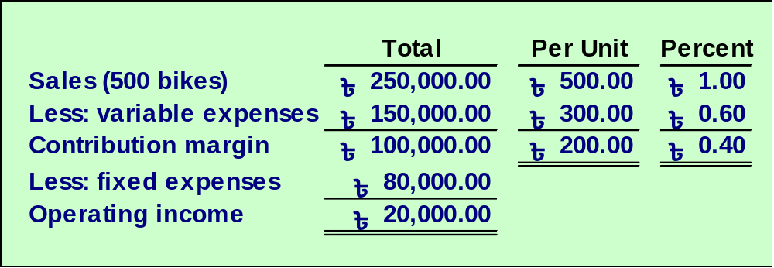
Business Applications of CVP
Consider the following information developed by the accountant at Speedo, a bicycle retailer:
<number>/64
Notes:
Speedo is a bicycle retailer who is currently selling 500 bikes at Tk 500 each and earning an operating income of Tk 20,000. Speedo is considering additional advertising and possible price reductions in order to boost income. We will use Speedo’s contribution format income statement to help Speedo make the advertising and pricing decisions.

Slide 45
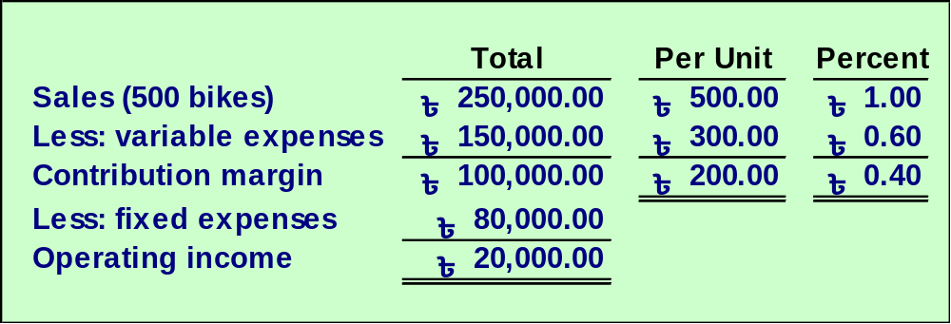
Business Applications of CVP
Should Speedo spend Tk 12,000 on advertising to increase sales by 10 percent?
<number>/64
Notes:
Speedo believes that an additional Tk 12,000 spent on advertising will increase sales by 10 percent. Is this a wise course of action for Speedo?

Slide 46
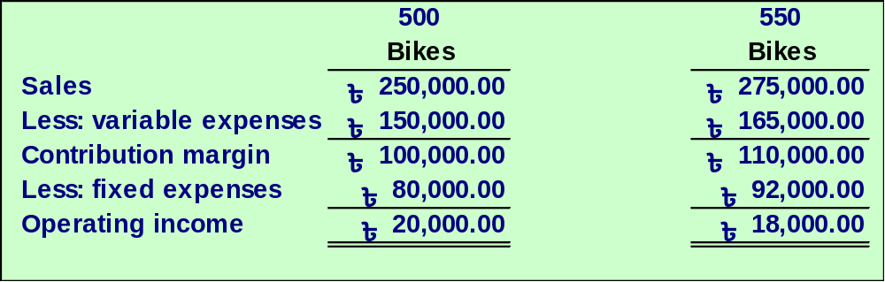
Business Applications of CVP
Should Speedo spend Tk 12,000 on advertising to increase sales by 10 percent?
550 × Tk 500
550 × Tk 300
Tk 80K + Tk 12K
No, income is decreased.
<number>/64
Notes:
A 10 percent increase in sales will increase the number of bikes sold from 500 to 550, and increase sales revenue from Tk 250,000 Tk to Tk 275,000. Variable expenses will also increase by 10 percent from Tk 150,000 to one Tk 165,000. The new contribution margin will be Tk 110,000, an increase of Tk 10,000. If Tk 12,000 is spent on advertising, fixed costs will increase from Tk 80,000 to Tk 92,000.
The Tk 10,000 increase in contribution margin is not enough to cover the Tk 12,000expenditure for advertising. This plan will reduce operating income from Tk 20,000 to Tk 18,000, so Speedo should not spend the money on advertising.

Slide 47
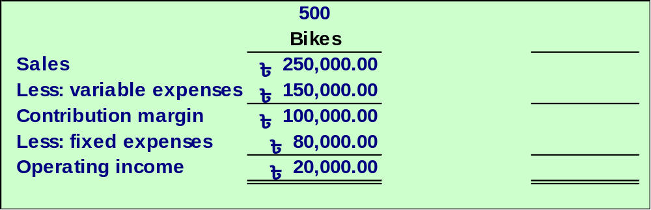
Business Applications of CVP
Now, in combination with the advertising,
Speedo is considering a 10 percent price reduction that will
increase sales by 25 percent. What is the income effect?
<number>/64
Notes:
Since we have shown Speedo that the previous plan should be rejected, Speedo is now considering a price reduction, combined with the Tk 12,000 advertising plan. Speedo believes that the advertising, along with a 10 percent off sale, will increase sales by 25 percent. Is this a wise course of action for Speedo?

Slide 48
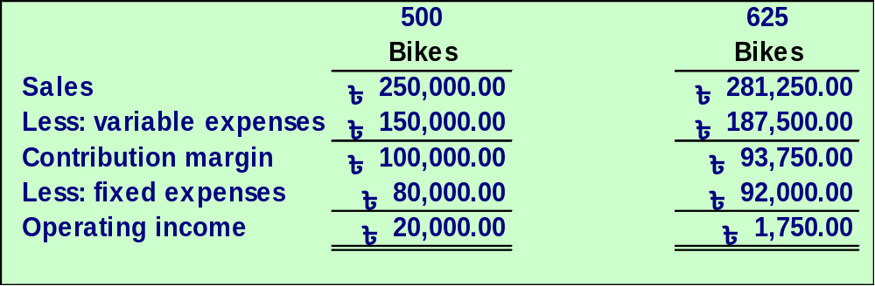
Business Applications of CVP
Now, in combination with the advertising,
Speedo is considering a 10 percent price reduction that will
increase sales by 25 percent. What is the income effect?
1.25 × 500
625 × Tk 450
625 × Tk 300
Tk 80K + Tk 12K
Income is decreased even more.
<number>/64
Notes:
A 25 percent increase in sales will increase the number of bikes sold from 500 to 625, and increase sales revenue from Tk 250,000 to Tk 281,250. Variable expenses will also increase by 25 percent from Tk 150,000 to Tk 187,500. The new contribution margin will be Tk 93,750, a decrease of Tk 6,250. If Tk 12,000 is spent on advertising, fixed costs will increase from Tk 80,000 to Tk 92,000.
This plan will reduce operating income even more, from Tk 20,000 to Tk 1,750, so Speedo should also reject this plan. A plan that reduces contribution margin while increasing fixed costs will always result in lower operating income.

Slide 49
Business Applications of CVP
Now, in combination with advertising and a price cut, Speedo
will replace Tk 50,000 in sales salaries with a Tk 25 per bike
commission, increasing sales by 50 percent above the
original 500 bikes. What is the effect on income?
<number>/64
Notes:
Speedo is not giving up. Now they are planning to reduce sales salaries by Tk 50,000, replacing the salaries with a Tk 25 per bike sales commissions. Speedo believes that the sales commission will motivate its sales staff to sell 50 percent more bikes. They still plan to spend the Tk 12,000 on advertising and cut the price by 10 percent. Is this a wise course of action for Speedo?

Slide 50
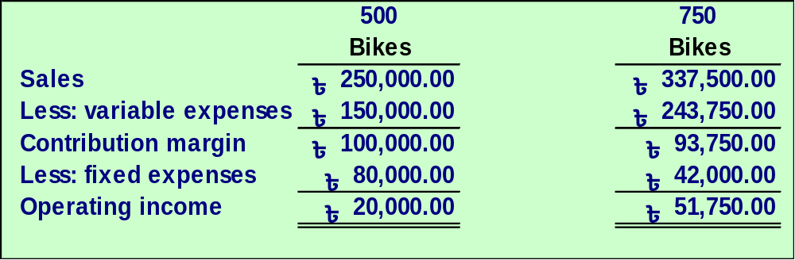
Business Applications of CVP
Now, in combination with advertising and a price cut, Speedo
will replace Tk 50,000 in sales salaries with a Tk 25 per bike
commission, increasing sales by 50 percent above the
original 500 bikes. What is the effect on income?
1.5 × 500
750 × Tk 450
750 × Tk 325
Tk 92K - Tk 50K
The combination of advertising, a price cut,
and change in compensation increases income.
<number>/64
Notes:
A 50 percent increase in sales will increase the number of bikes sold from 500 to 750, and increase sales revenue from Tk 250,000 to Tk 337,500. Variable expenses, which were Tk 300 per bike are now Tk 325 per bike. Total variable expenses are 750 bikes at Tk 325 each for a total of Tk 243,750. The new contribution margin will be Tk 93,750, a decrease of Tk 6,250. Fixed expenses will be reduced from Tk 80,000 to Tk 42,000 (Tk 80,000 plus Tk 12,000 for advertising minus the Tk 50,000 salary reduction).
This plan also reduces contribution margin by Tk 6,250, but the Tk 38,000 decrease in total fixed costs is greater than the Tk 6,250 decrease in contribution margin, so operating income will increase by Tk 31,750.

Slide 51
Business Applications of CVP
Should Speedo use higher quality parts would increase variable costs
by Tk 10. However, the sales manager believes that the higher quality parts
will increase bike sales from 500 units to 540 units.
Should the increase be approved?
<number>/64
Notes:
Since we have shown Speedo that the previous plan should be rejected, Speedo is now considering a price reduction, combined with the Tk 12,000 advertising plan. Speedo believes that the advertising, along with a 10 percent off sale, will increase sales by 25 percent. Is this a wise course of action for Speedo?

Slide 52
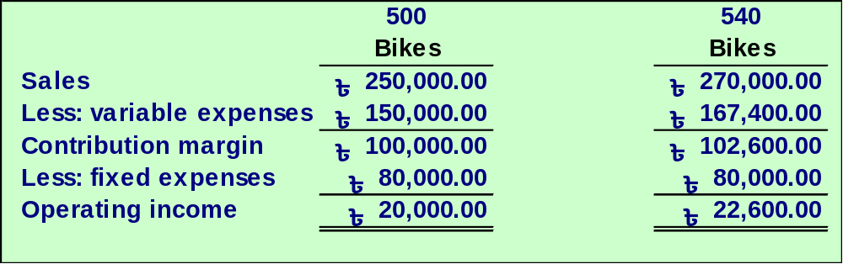
Business Applications of CVP
Should Speedo use higher quality parts would increase variable costs
by Tk 10. However, the sales manager believes that the higher quality parts
will increase bike sales from 500 units to 540 units.
Should the increase be approved?
500+40
540 × Tk 500
540 × Tk 310
Net income increases by Tk 2,600.
So, it’s acceptable
<number>/64
Notes:
A 25 percent increase in sales will increase the number of bikes sold from 500 to 625, and increase sales revenue from Tk 250,000 to Tk 281,250. Variable expenses will also increase by 25 percent from Tk 150,000 to Tk 187,500. The new contribution margin will be Tk 93,750, a decrease of Tk 6,250. If Tk 12,000 is spent on advertising, fixed costs will increase from Tk 80,000 to Tk 92,000.
This plan will reduce operating income even more, from Tk 20,000 to Tk 1,750, so Speedo should also reject this plan. A plan that reduces contribution margin while increasing fixed costs will always result in lower operating income.

Slide 53
Learning Objective
To determine semi variable
cost elements.
LO8
<number>/64
Notes:
Learning objective number 9 is to determine semivariable cost elements.

Slide 54
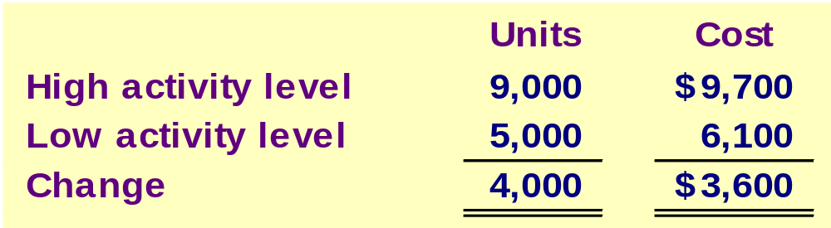

The High-Low Method
Matrix, Inc. recorded the following production activity and maintenance costs for two months:
Using these two levels of activity, compute:
the variable cost per unit.
the total fixed cost.
total cost formula.
<number>/64
Notes:
When presented with a semivariable (mixed) cost, we will separate the variable portion of the cost from the fixed portion of the cost. The High-low method is one way that we can accomplish that.
In our example, we’re going to look at a company’s relationship between maintenance cost and units of production . During the year, the company reports production and maintenance costs on a monthly basis. The month with the high level of production shows 9,000 units and a corresponding maintenance cost of Tk 9,700, and the month with the low level of production shows Tk 5,000 units with a corresponding cost of Tk 6,100. We will use this information to compute the variable cost per unit of production and the total fixed cost. Then we will write a linear equation to describe the cost behavior.

Slide 55
The High-Low Method
∆ in cost
∆ in units
Tk 3,600
4,000
Unit variable cost = = = Tk 0.90 per unit
<number>/64
Notes:
To determine the variable costs per unit of activity, we divide the change in cost by the change in production activity. In our case, the change in cost is Tk 3,600 and the change in units produced is 4,000. The result is a variable cost rate of ninety cents per unit produced.

Slide 56
The High-Low Method
∆ in cost
∆ in units
Tk 3,600
4,000
Unit variable cost = = = Tk 0.90 per unit
Fixed cost = Total cost – Total variable cost
<number>/64
Notes:
Next, we calculate the fixed cost by subtracting the total variable cost from the total cost. Since total cost and total variable cost are different amounts at different activity levels, we must choose either the high level or the low level for our computations.

Slide 57
The High-Low Method
∆ in cost
∆ in units
Tk 3,600
4,000
Unit variable cost = = = Tk 0.90 per unit
Fixed cost = Total cost – Total variable cost
Fixed cost = Tk 9,700 – (Tk 0.90 per unit × 9,000 units)
Fixed cost = Tk 9,700 – Tk 8,100 = Tk 1,600
<number>/64
Notes:
Let’s choose the high level of activity, 9,000 units. Our first step is to calculate the total variable cost. At 9,000 units, the total variable cost is ninety cents per unit times 9,000 units resulting in a total variable cost of Tk 8,100. Next, we subtract Tk 8,100 from the total cost at the high activity, to get the fixed cost, Tk 1,600. We will obtain the same result if we select the low level of activity to compute fixed cost. Why don’t you verify this by computing the fixed cost using the low level of sales activity before advancing to the next slide.

Slide 58
The High-Low Method
∆ in cost
∆ in units
Tk 3,600
4,000
Unit variable cost = = = Tk 0.90 per unit
Fixed cost = Total cost – Total variable cost
Fixed cost = Tk 9,700 – (Tk 0.90 per unit × 9,000 units)
Fixed cost = Tk 9,700 – Tk 8,100 = Tk 1,600
Total cost = Tk 1,600 + Tk .90 per unit
<number>/64
Notes:
Now, we can write a linear equation using our variable cost of ninety cents per unit and our fixed cost of Tk 1,600. We know that total cost is equal to the sum of the fixed cost and the variable cost, so total cost equals Tk 1,600 plus ninety cents per unit for any number of units within the relevant range. Let’s look a a couple of questions to illustrate the high-low method.

Slide 59
The High-Low Method
If sales commissions are Tk 10,000 when 80,000 units are sold and Tk 14,000 when 120,000 units are sold, what is the variable portion of sales commission per unit sold?
a. Tk .08 per unit
b. Tk .10 per unit
c. Tk .12 per unit
d. Tk .125 per unit
<number>/64
Notes:
Here’s your first question.

Slide 60
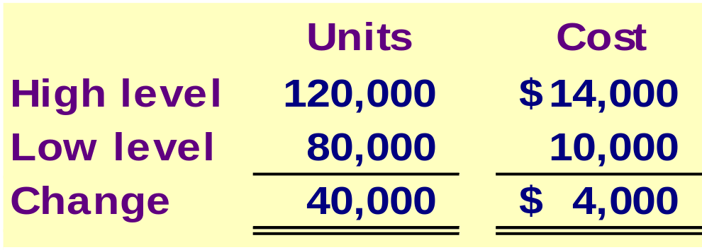
The High-Low Method
If sales commissions are Tk 10,000 when 80,000 units are sold and Tk 14,000 when 120,000 units are sold, what is the variable portion of sales commission per unit sold?
a. Tk .08 per unit
b. Tk .10 per unit
c. Tk .12 per unit
d. Tk .125 per unit
Tk 4,000 ÷ 40,000 units
= Tk .10 per unit
<number>/64
Notes:
To find the variable costs per unit of activity, we divide the change in sales commissions by the change in units sold. In our case, the change in sales commissions is Tk 4,000 and the change in units sold is 40,000. The result is a variable cost rate of ten cents per unit sold.

Slide 61
The High-Low Method
If sales commissions are Tk 10,000 when 80,000 units are sold and Tk 14,000 when 120,000 units are sold, what is the fixed portion of the sales commission?
a. Tk 2,000
b. Tk 4,000
c. Tk 10,000
d. Tk 12,000
<number>/64
Notes:
Here’s your second question. You will use the variable cost per unit from the first question to compute the fixed cost in this question

Slide 62
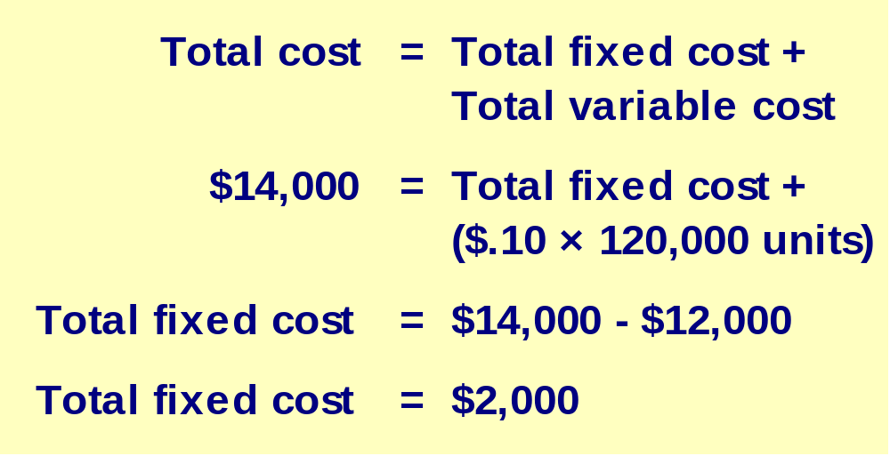
The High-Low Method
If sales commissions are Tk 10,000 when 80,000 units are sold and Tk 14,000 when 120,000 units are sold, what is the fixed portion of the sales commission?
a. Tk 2,000
b. Tk 4,000
c. Tk 10,000
d. Tk 12,000
<number>/64
Notes:
Let’s choose the high level of activity, 120,000 units. Our first step is to calculate the total variable cost. At 120,000 units, the total variable cost is ten cents per unit times 120,000 units resulting in a total variable cost of Tk 12,000. Next, we subtract Tk 12,000 from the Tk 14,000 total cost at the high activity, to get the fixed cost, Tk 2,000. You may have chosen to begin with the low level of activity, but your answer should be the same.

Slide 63
Assumptions Underlying CVP Analysis
A limited range of activity, called the relevant
range, where CVP relationships are linear.
  Unit selling price remains constant.
  Unit variable costs remain constant.
  Total fixed costs remain constant.
Sales mix remains constant.
Production = sales (no inventory changes).
<number>/64
Notes:
There are some basic assumptions related to cost volume profit analysis that we have studied in this chapter. Some of these assumptions may be very restrictive. First, costs and revenues are assumed to be linear in nature, meaning that the selling price is assumed to be constant, the unit variable cost is assumed to be constant, and total fixed costs are assumed to be constant.. Second, for multiproduct companies, the sales mix is assumed to be constant. Also, for manufacturing companies, inventories don’t increase or decrease during the period. All units produced, are sold.

Slide 64
End of Lecture 06
THANK YOU ALL…

